Slide 1

Armed Forces College of Medicine
AFCM

Slide 2
Investigations of patient with abnormal liver tests
Yasser Omar M.D.

Slide 3
ILOs
By the end of this lecture the student will be able to:
Differentiate between acute and chronic liver diseases
Determine the different presentations of the patients with elevated liver enzymes
Recognize the complications of acute hepatitis
Recognize step wise approach to a patient with elevated liver enzymes
Understand how to put a differential diagnosis for a patient with elevated liver enzymes

Slide 4
Liver functions vs liver tests
Some liver tests reflects functional capability of the liver, synthetic function (albumin, coagulation factors) or conjugation ability (bilirubin direct and indirect). While some liver tests reflect cellular integrity (ALT and AST for hepatocytes / ALP and GGT for cells lining biliary radicles).
So, liver enzyme; ALT, AST, ALP and GGT are not liver functions.

Slide 5
Normal Liver Profile
Total Bilirubin: | mg/dl (N= 0.1 - 1.0)
Direct Bilirubin: | mg/dl (N= 0.0 - 0.25)
AST: | U/L (N= 0 - 32)
ALT: | U/L (N= 0 - 31)
Alkaline phosphatasc: | U/L (N= 79 - 240)
Total protein | g/dl (N= 6.6 - 8.6)
Albumin | g/dl (N= 3.5 - 5.5)
Prothrombin time (PT) INR | 11 - 13.5 seconds. 0.8 - 1.1

Slide 6
History
A detailed history should be taken with a particular emphasis on:
alcohol consumption.
risk factors for viral hepatitis (intravenous drug use, sexual promiscuity, homosexual relations, tattoos, non-sterile ear or body piercing, blood or blood product transfusions).
medications used currently or previously.
herbal or alternative remedies.
occupational exposure to toxins.

Slide 7
History
History is the only method to discover certain etiologies of liver diseases and to give the explanation of abnormal liver tests

Slide 8
Clinical examination
A full physical examination must be performed with special emphasis on stigmata of chronic live disease, cirrhosis, and liver cell failure.

Slide 9
Case 1
S. A. is a 19 yrs old girl presented to a GP clinic with nausea, vomiting and two attacks of diarrhea … the patient informed the The physician that she noticed a mild fever and dark colored urine …he reassured her and told here this is a case of gastroenteritis …and the dark urine is due to decrease fluid intake ,he gave her antibiotics and let her to go home
Criticize the action of the physician?

Slide 10
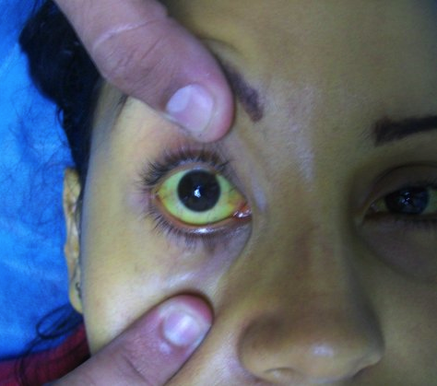
The pt started to notice marked malaise , recurrent vomiting … her mother noticed yellowish discoloration of the sclera, she went to a specialist ….

Slide 11
lab
the physician ordered blood tests were :
the ALT was 1750 iu/ (ULN 35)
AST 1450 (ULN 35)
total bilirubin 12mg/dl <1.1
direct bilirubin of 6mg/dl<0.25
What do u think … what investigations should be ordered next?

Slide 12
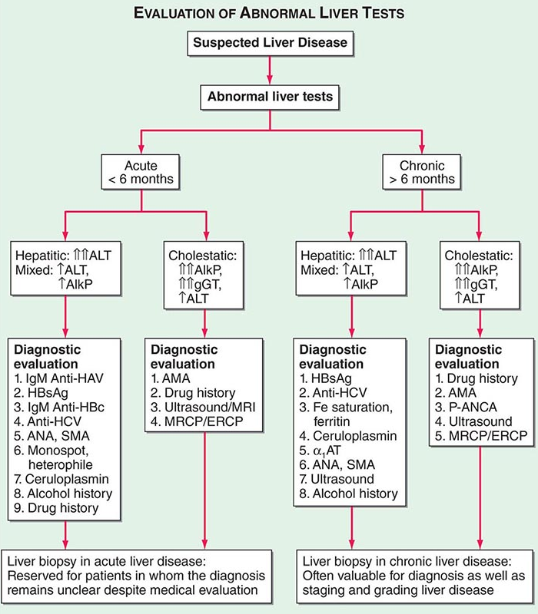

Slide 13
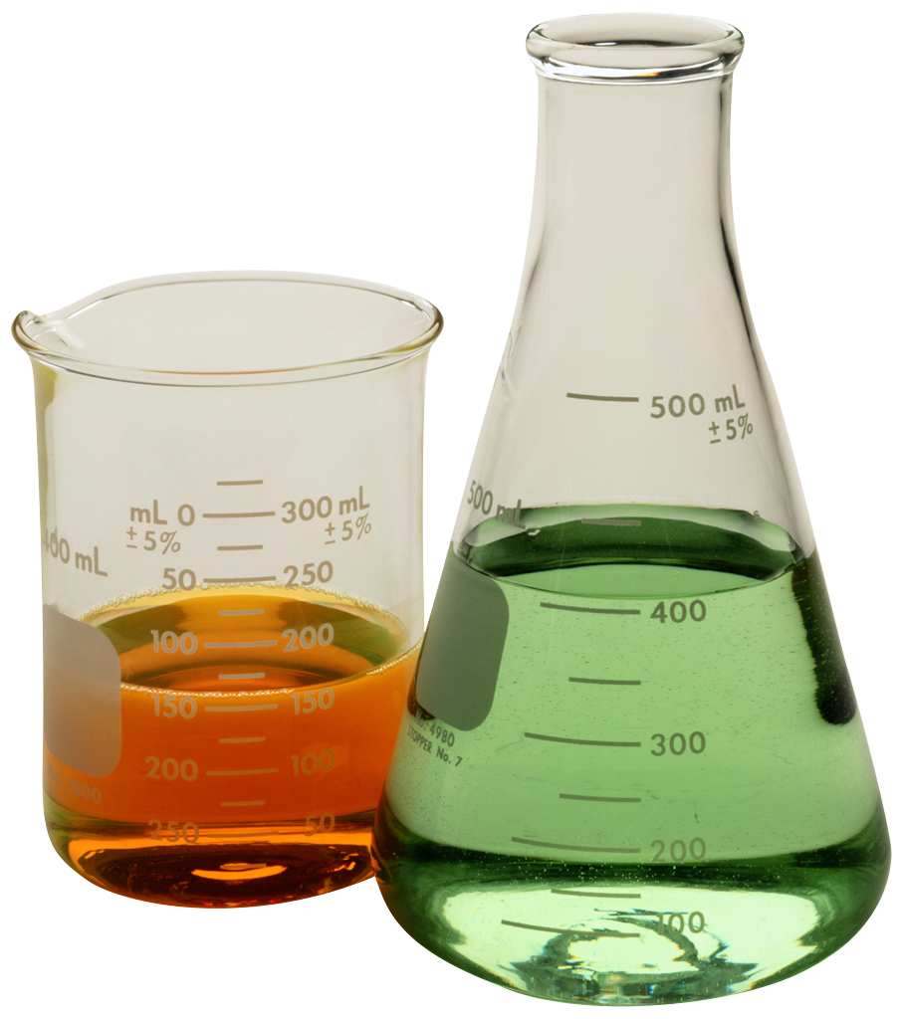
CBC
Serum albumin
Prothrombin time and INR
HAV Ab Ig M and Ig G
HbsAg
HCVab???
Abd US.

Slide 14
Diagnosis
HAV ab IGM +ve
PT: 11 sec
Albumin 4.3 g/dl
A case of compensated acute hepaitis A

Slide 15

The physician reassured her and advised her again antibiotics.. High CHO diet and let her to go home….
What’s your opinion?

Slide 16
10 days later the patient became markedly ill with marked lower limb oedema … she started to have epistaxsis with impaired mental status… she was transferred to hospital and was admitted to ICU

Slide 17
The new investigations revealed in addition to the marked elevated bil.,AST,ALT were:
S . albumin 2.3gm/dl
Total proteins 7gm/dl
Prothrombin time 18 sec with INR 2.1

Slide 18
Diagnosis
Acute live failure (fulminant hepatitis, complicating acute viral hepatitis A)

Slide 19
Acute hepatitis pattern
Total Bilirubin: | Increased (N= 0.1 - 1.0)
Direct Bilirubin: | Increased (N= 0.0 - 0.25)
AST: | More than 10 ULN (N= 0 - 32)
ALT: | More than 10 ULN (N= 0 - 31)
Alkaline phosphatasc: | Mild increase (N= 79 - 240)
Total protein | Normal (N= 6.6 - 8.6)
Albumin | Normal (N= 3.5 - 5.5)

Slide 20

Case 2
A. A. , a 35 yrs old man , was travelling to join a job in the Gulf area, they requested a health certificate … he went to a lab , gave a blood sample ..

Slide 21
DD acute hepatitis
Acute viral hepatitis
Acetaminophen toxicity
Shock liver
Toxic hepatitis
Autoimmune hepatitis

Slide 22
2 days later the lab called him an told him that his ALT is 87 <35 and AST 85<34 and advised him for further investigations..
What do you think? And what further investigations would you like to advise ?

Slide 24
Investigations
The patient went to a specialist who ordered the following investigation?
HBsAg
HCV ab
Rest of LFTs ( bil T & d), albumn, total proteins
INR
Abd US

Slide 25
the patient found to have HCV Ab +ve by third generation ELISA…….What is further?

Slide 26
HCV PCR was 2000,000 IU
Albumin 4.3 gm/dl
PT= 12 sec.
Abd. U/S: mild coarse liver
A case of compensated chronic HCV

Slide 27
Management
Patient should be linked to care For Direct Acting Antiviral Treatment

Slide 28
Further DD of chronic hepatitis
If the previous patient was HCV Ab –ve
What are the other possible cause(s) and how to treat ?

Slide 29
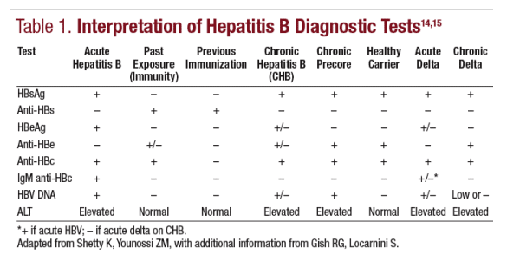
HBV profile

Slide 30
Other causes
Viral hepatitis caused by non hepatitis viruses.
EBV… CBC….monocytosis and .EBV Ig M +ve
CMV…..CBC………. atypical lymphocytosis and CMV Ig M +ve
Metabolic liver diseases: hemochromatosis, Wilson ds, alpha 1 anitrypsin def., NASH.
Autoimmune liver diseases

Slide 31
Chronic liver disease/cirrhosis
Total Bilirubin: | Increased mg/dl (N= 0.1 - 1.0)
Direct Bilirubin: | Increased mg/dl (N= 0.0 - 0.25)
AST: | Less than 10 ULN (N= 0 - 32)
ALT: | Less than 10 ULN (N= 0 - 30)
Alkaline phosplialasc: | Normal or mild increase (N= 79 - 240)
Albumin: | decreased (N= 3.5 - 5.5)
In compensated chronic liver disease/ cirrhosis (CHILD A): all functions are normal + increased transaminases
In decomensated chronic liver diseases/cirrhosis (CHILD B & C) abnormal functions + increased ransaminases

Slide 32
Case 3
A45 yrs old male with body mass index of 33 came with accidental discovery of AlT of 78 <34 and AST of 86<35 , all viral and autoimmune markers are –ve
What do u think…how to prove your diagnosis?

Slide 33
Investigations
Impaired glucose tolerance may be present
Hypertriglyceridemia may be present

Slide 34
NASH
AST>Alt
US
MRI spectroscopy
??liver biopsy ( invasive)

Slide 35
Case 4
A 22 yrs. old female with IDDM. c/o itching found to have highly elevated liver enzymes and bilirubin.
Ultrasound examination was unremarkable.
The laboratory examination showed a negative serology for hepatitis A, B and C,
ALT 76 IU/l AST 66 IU/l
Albumin 4 g/dl PT 11.5 sec
Bilirubin 1 mg/dl

Slide 36
marked immunoglobulin G (IgG) elevation and hypergammaglobulinaemia
Liver biopsy and analysis of autoimmune antibodies were performed showing high titers of antinuclear antibodies (ANA) and smooth muscle antibodies (SMA).

Slide 37
Diagnosis :Autoimmune hepatitis

Slide 38
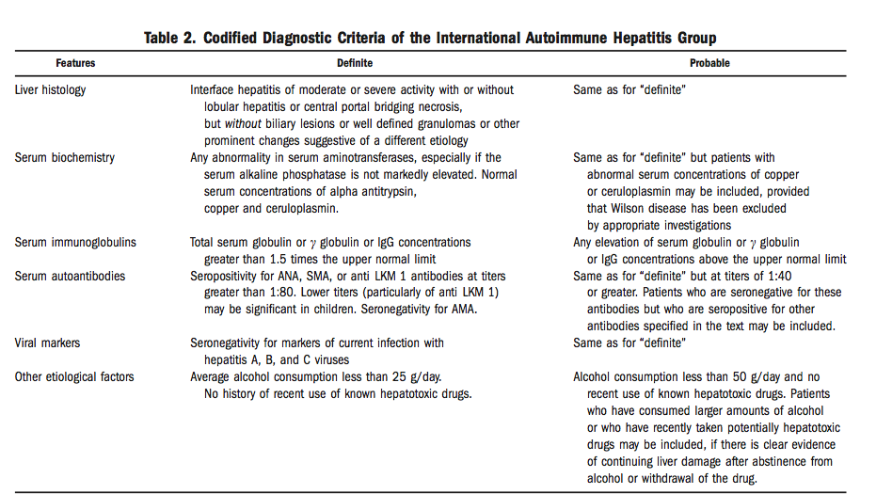

Slide 39
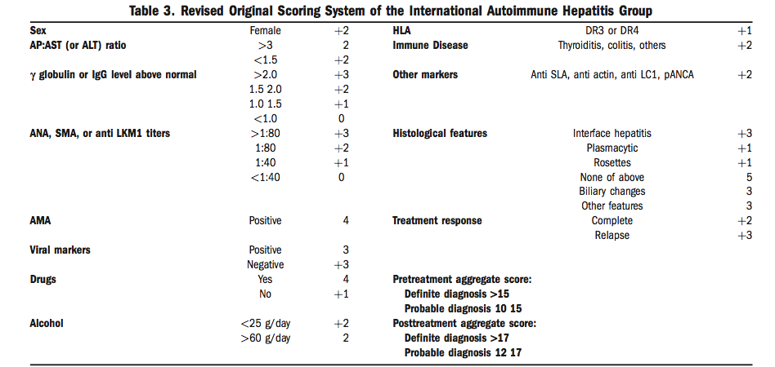

Slide 40
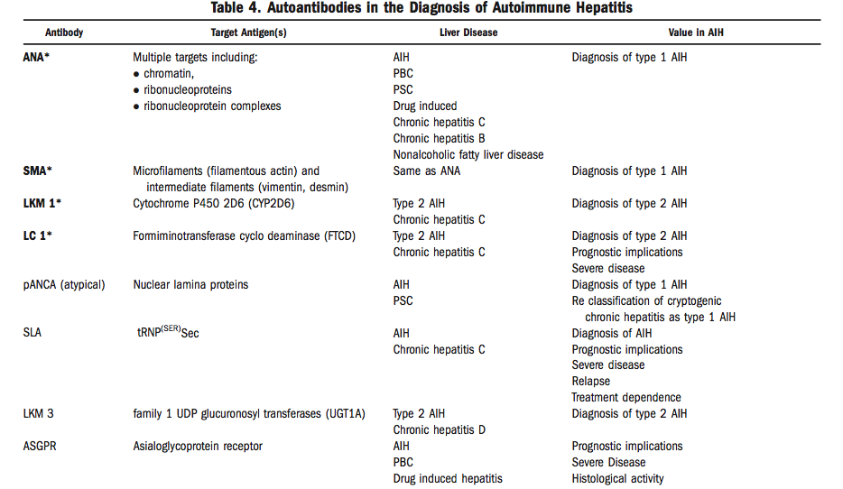

Slide 41
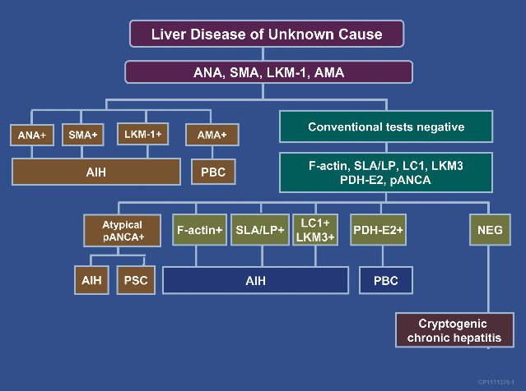

Slide 42
Case 4
A 19 yrs old female from Yemen came with jaundice ,lower limb edema , pallor and dysarthia…
Her total bilirubin was 8 direct 3 , AST ,ALT 10 fold increased, her Hb % was 8 with corrected reticulocytic index 3 .. All auto- immune markers were –ve.]

Slide 43
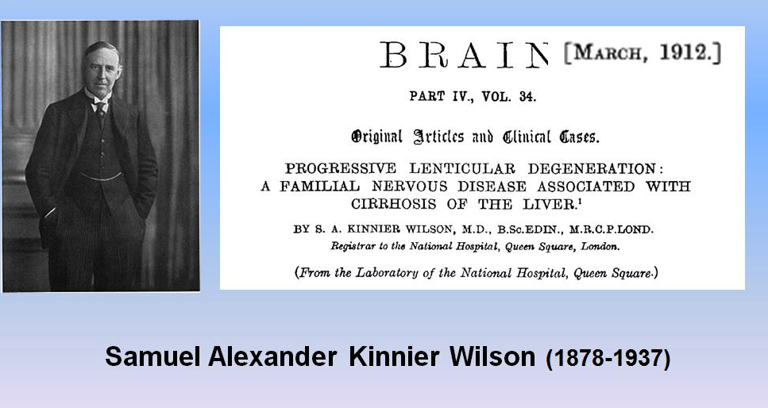
Wilson’s disease

Slide 44
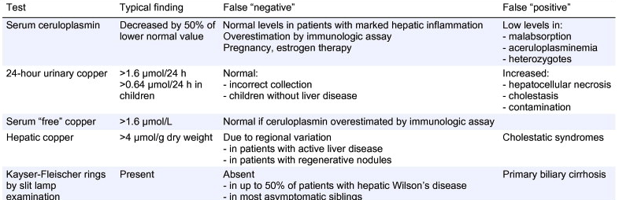
Diagnostic tests for wilson’s disease

Slide 45
Treatment of wilson’s disease
Penicillamine A chelating agent, penicillamine can cause serious side effects, including skin problems, bone marrow suppression and worsening of neurological symptoms.Trientine (Syprine).
Trientine works much like penicillamine but tends to cause fewer side effects.
Zinc acetate (Galzin). Decrease absorption of copper.

Slide 46
Case 5
Mr. Ali 65 years old, presented with upper abdominal dull aching pain of 2 monthes duration associated with anorexia and weight loss.
Yellowish discoloration of the eyes were noted
With dark urine.
What are investigations you will ask for?

Slide 47
Serum bilirubin : 8 mg/dl
Direct bilirubin 6.9 mg/dl
ALT 28 U/L
AST 30U/L
ALP 488 U/L
GGT 300 U/L
What is next????????

Slide 49
Abdominal ultrasound:
Dilated intrahepatic biliary radicles
MRCP: Pancreatic head mass

Slide 50
Take home message
Knowledge of pattern of elevated liver profile is important to select the definitive diagnostic investigations

Slide 51
Refrences
Benjamin IJ, Griggs RC, Wing EJ, Fitz JG (Eds.) (2016). Andreoli and Carpenter’s Cecil Essentials of Medicine (9th ed.). Philadelphia, PA: Elsevier Saunders.
Fauci, AS, Kasper DL, Hauser SL, Longo DL, Loscalzo J (Eds.) (2018). Harrison's Principles of Internal Medicine (20th ed.). New York: McGraw-Hill Education.

Slide 52
Thank You

